Slide 1
AI Maturity Model for Production (AIM2prod)
Enterprise Architecture AI Tutorial
Draft June 15, 2023
John R. Frank, PhD

Slide 2
AI Maturity Levels for Production Software Engineering
 |  |  |  |  | L5 | User experience changes inspired by AI process.
 |  |  |  | L4 | Using bake-offs and error analysis to improve user effectiveness.
 |  |  | L3 | Capturing judgements on real test data with written guidelines.
 |  | L2 | Recording & studying metrics of usage and user feedback (stories).
 | L1 | Identified outputs that impact human effectiveness & that can be judged.
L0 | Documented APIs, versioned, regression tests, used by other engineers.

Slide 3
Foundational AI Strategies
for Software Engineering
Detectors
Rankers
Mergers
Three Canonical Examples

Slide 4
AI Engineering Strategy Template (best practices)
Measure Quality: Identify restricted Turing tests at module boundaries.
General Turing tests: open-ended conversation → single judgement of is intelligent or not.
Restricted Turing tests: simplified story templates → repeated judgements that we count.
Leverage standard metrics, e.g. from NIST
Use Real Data: Establish baseline measurements on operational data.
Use existing operational system or simplest possible rule-based function.
Make a test harness that records human judgements –– usually new code.
Crucial: document guidelines with examples of edge cases, so we can train more judges.
Improve Quality: Run offline contests or “bake offs”:
Periodically upgrade input/output APIs of modules, so new AI approaches can run on tests.
Crucial: save historical outputs of test runs for each iteration of new AI algorithms.
Error Analysis: periodically study errors in past runs to identify opportunities for paths forward.

Slide 5
Three Standard Templates for AI Engineering
Transparently Honest ChatBot Assistants (hypothetical future)
AI strategists for any given project must pick focus areas to apply effort.
Mergers
Rankers
Reward
Detectors
Combinations of rankers. Closer to human-like end-to-end complete system
Simple human-machine user experience
Simplest Modularity
Risk

Slide 6
Three Standard Templates for AI Engineering
Detectors:
Input: small complex data + defined type of thing, output is trivial yes/no (often plus/minus)
Restricted Turing Test: human can read/see/hear input to determine yes/no.
Examples:
Is this a phone number from region X?
Is this a photo of thing X?
Rankers:
Input: massive complex data + user request, output is ordered list of responses.
Restricted Turing Test: human reviews list, accepting/rejecting answers.
Examples:
What should I read about topic X?
Give me new factoids of type X to add to my report on topic Z.
Mergers:
Input: massive complex data + user request + schema of ideal output → populated schema
Restricted Turing Test: human accepts/rejects data in each field.
Examples:
Route me to points A, B, C efficiently given current traffic.
Organize my chemistry experiments to find best procedure for synthesizing X.

Slide 7
Metrics for Detectors
Detectors:
Several standard metrics computed from building a “confusion matrix”
Different metrics aim at different goals
Often implemented with a numerical score computed for each input and then a threshold that decides whether an output is positive (above threshold) or negative (below threshold).
Example:
Rate of false positives
3% = 295 / 9477 → Precision = 97%
Rate of missed detections
88% = 48279 / 54764 → Recall = 12%
Aggregate “accuracy” is:
24% = (9,182 + 6,485) / (9,477 + 54,764)
F1 score
harmonic mean of precision & recall:
2 * prec * recall / (precision + recall)
In this example: 21%
Confusion Matrix (example) |  | Human Judgement
 |  | True | False | Totals
System Output | Positive | 9,182 | 295 | 9,477 (above threshold)
 | Negative | 6,485 | 48,279 | 54,764 (below threshold)

Slide 8
Metrics for Rankers
Rankers:
Metrics count effort required by user to read down the list and find good result(s)
Nuanced judgment about what counts as a “good” result, e.g. not redundant with earlier hits.
Like a detector with threshold lowered to allow higher recall with lower precision.
Expected Reciprocal Rank (ERR) is a widely used scoring function.
Q1 | Q2 | Q3
R1.1 R1.2 R1.3 R1.4 R1.5 | R2.1 R2.2 R2.3 R2.4 R2.5 | R3.1 R3.2 R3.3 R3.4 R3.5
Ranking metrics tend to be precision focused.
Quantifying recall requires more judgments.
1 2 4 ERR = avg( 1 + ½ + ¼ ) = 7/12
first good hit

Slide 9
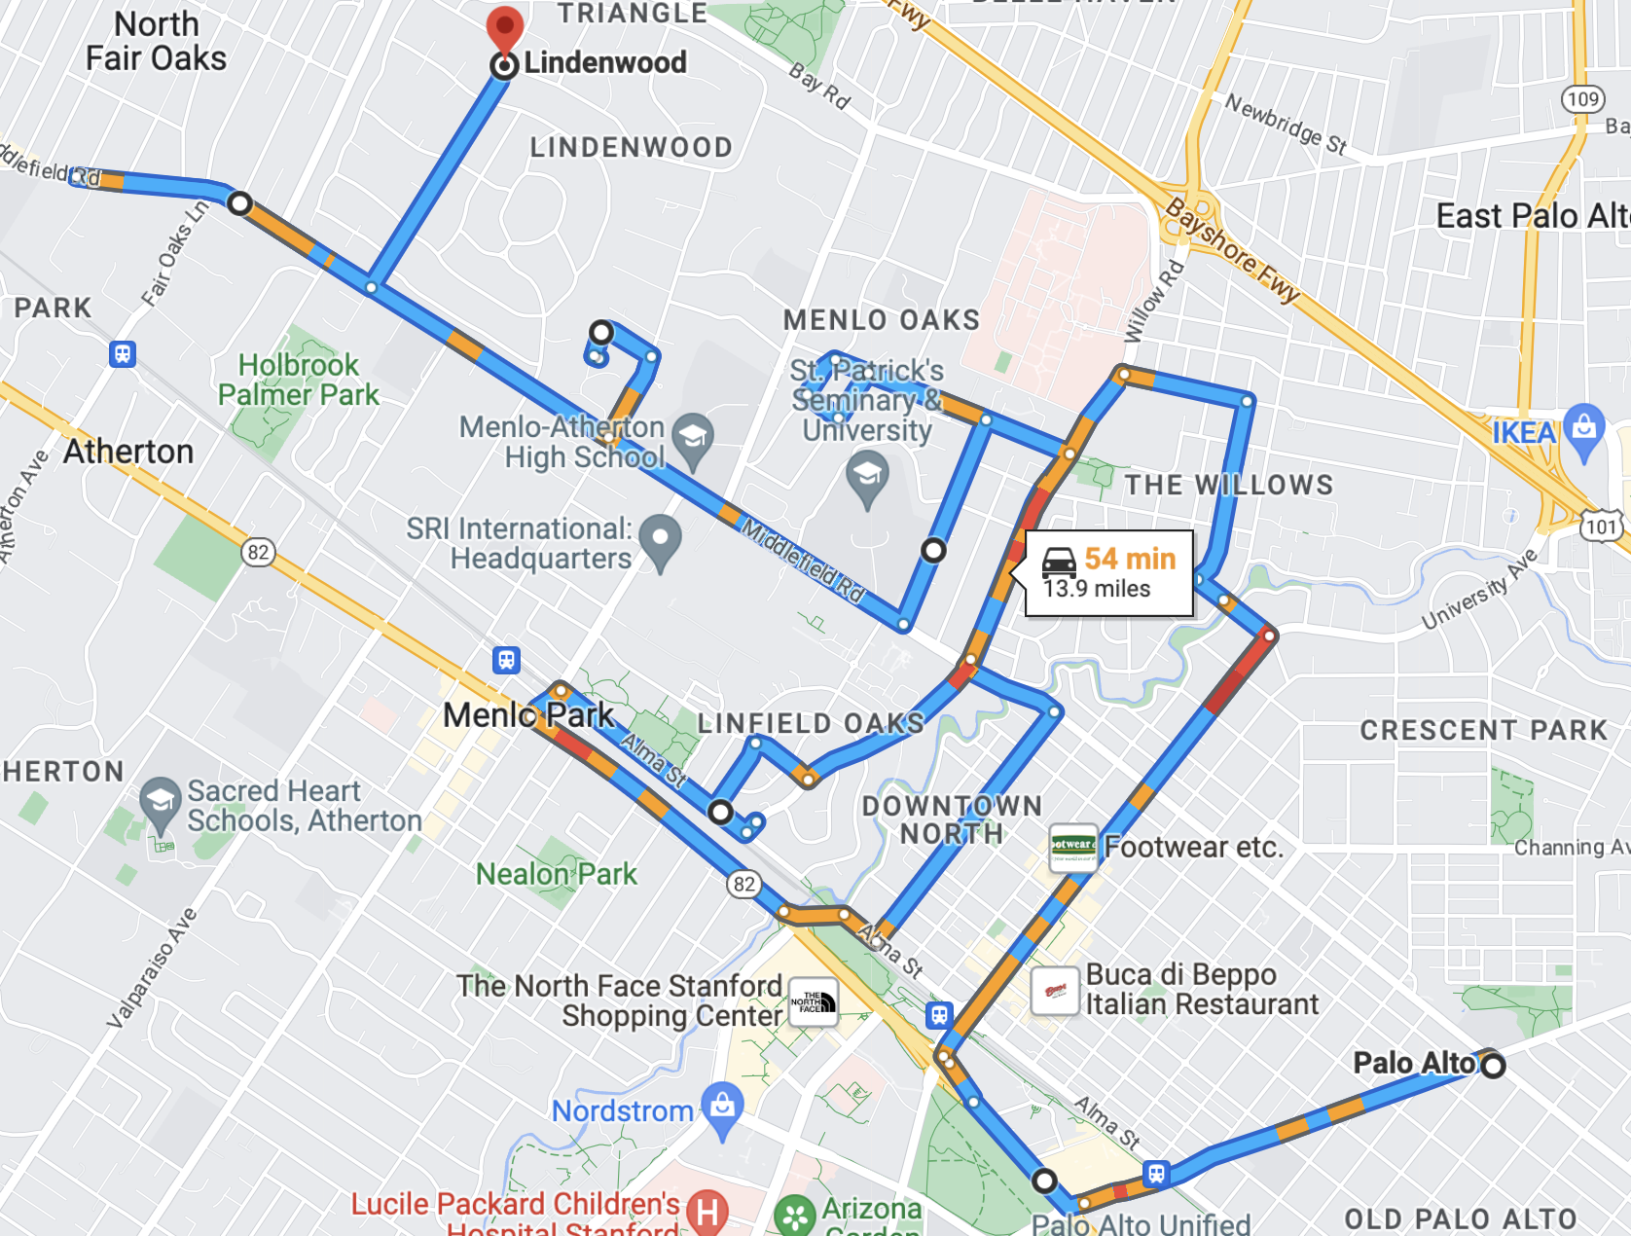
Metrics for Mergers
Mergers:
Metrics based on comparison of output with a human-assembled work product.
Detector-like: Count human accept/reject elements from merger?
Quantify Recall: What did the human find without the merger, what did the merger add?
Gap analysis → Rumsfeld's Matrix of Epistemic Uncertainty
Known Knowns | Known Unknowns
Unknown Knowns | Unknown Unknowns
Many roads and bridges were destroyed, and international maritime travel was blocked by the 2022 Russian invasion of Ukraine.^{[241]} Before that it was mainly through the Port of Odesa, from where ferries sailed regularly to Istanbul, Varna and Haifa. The largest ferry company operating these routes was Ukrferry.^{[258]} There are over 1,600 km (1,000 mi) of navigable waterways on 7 rivers, mostly on the Danube, Dnieper and Pripyat. All Ukraine's rivers freeze over in winter, limiting navigation.^{[259]}
Ukraine's rail network connects all major urban areas, port facilities and industrial centres with neighbouring countries.^{[citation needed]} The heaviest concentration of railway track is the Donbas region.^{[260]} Although rail freight transport fell in the 1990s, Ukraine is still one of the world's highest rail users.^{[261]}
Ukraine International Airlines, is the flag carrier and the largest airline,^{[262]} with its head office in Kyiv^{[263]} and its main hub at Kyiv's Boryspil International Airport. It operated domestic and international passenger flights and cargo services to Europe, the Middle East, the United States,^{[222]} Canada,^{[264]} and Asia.
Energy in Ukraine is mainly from gas and coal, followed by nuclear then oil.^{[170]} The coal industry has been disrupted by conflict.^{[265]} Most gas and oil is imported, but since 2015 energy policy has prioritised diversifying energy supply.^{[266]}
About half of electricity generation is nuclear and a quarter coal.^{[170]} The largest nuclear power plant in Europe, the Zaporizhzhia Nuclear Power Plant, is in Ukraine. Fossil fuel subsidies were US$2.2 billion in 2019.^{[267]} Until the 2010s all of Ukraine's nuclear fuel came from Russia, but now most does not.^{[268]}
Merger
Found only by merger
Human
Found only by human

